Slide 1
Web Crawling
By: Luis Liang, Nathan Lin,
Mauricio Rivera, Anahit Sarao
San Jose State University, College of Engineering
Notes:
Luis

Slide 2
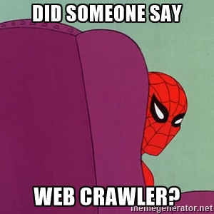

Slide 3
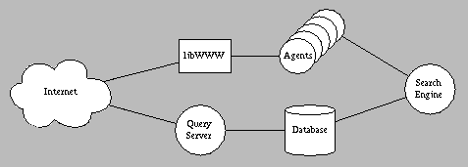
Introduction
What is Web-Crawler and it use for?
How does a Typical Web-Crawler looks?
How can be improved?
Design and Analysis of a Web-Crawler
Design & Testing
Difficulties
Improvements
Demo of a Web-Crawler
Conclusion
Image Retrieved from: <http://www.thinkpink.com/bp/webcrawler/www94.html>
Notes:
Nathan

Slide 4
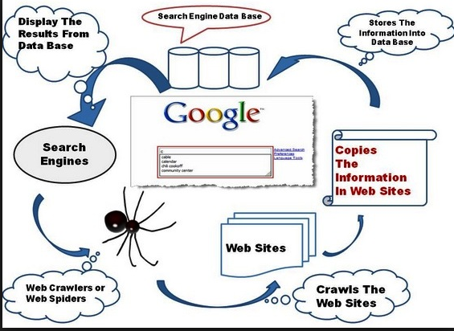
What is a web-crawler?
Image retrieved from<http://tutorial.razi.net.my/2015/06/what-is-web-crawler.html>
Knows as a Web-Spider (a software program)
To the general public, it is known as World-Wide Search Engine.
Web-Crawlers are to assist search engines to store and organize (index) sites on a list.
Instructions - “robot.txt”
Notes:
Nathan

Slide 5
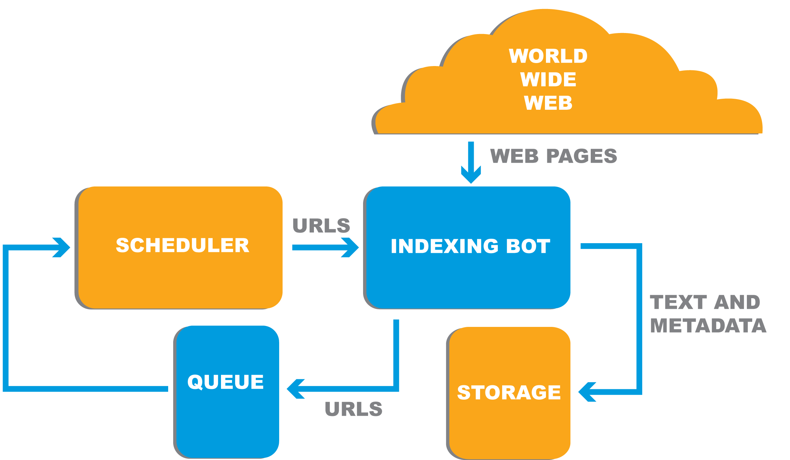
What is a crawler used for?
To Optimizes Search Engines:
Starts with most popular sites searching for key-words(input from user). If value is true, URL site is stored for future processing while optimizing the user experience.
Image Retrieved from: <http://freshdesignza.ca/blog/adapting-search-engine-evolution/>
Notes:
Nathan

Slide 6
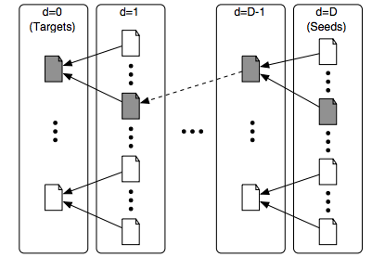
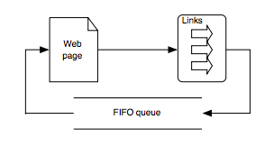
Typical web-crawlers...
Basic crawler with seed page and targets(gray) Breadth-First Crawler
The web crawlers used the more often are Breadth First, Best-First, Page Rank, and InfoSharks
Notes:
Mauricio

Slide 7
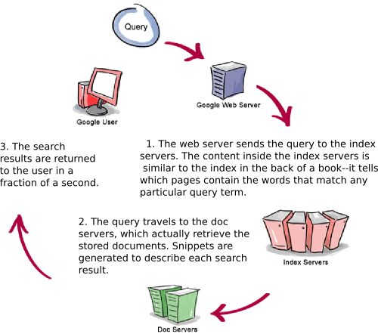
Enhancements
Googlebot:
A well known Web-Crawler
Has help Google, Inc. dominate the World-Wide Web Search.
Image retrieved from <Copyright © 2003 Google Inc.>
Notes:
Luis

Slide 8
Design and Analysis

Slide 9
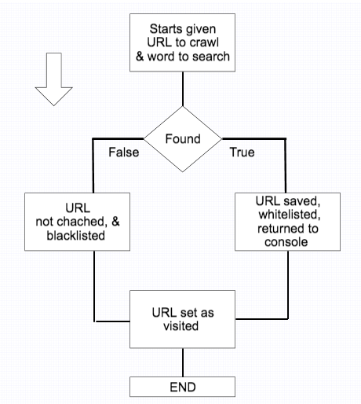
Design of Web Crawler
Language: Python:
HTML Parser
URL API
Web Crawler connects to the site and searches for word/phrases. If found, returns true to the console while whitelisting the URL site. Else, the cached URL searched for becomes blacklisted.
Notes:
Anahit

Slide 10
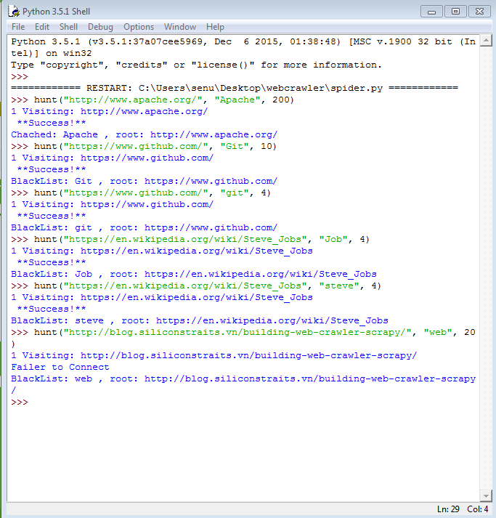
Testing
Python build 3.5.1 was used to create this web crawler. The testing environment is [GCC 4.2.1 Compatible Apple LLVM 6.0 (clang-600.0.57)] on darwin. To load the script within the Python interpreter, the command exec(open('./spider.py').read()). Using IDLE bypassing this command.
Notes:
Anahit

Slide 11

Difficulties
Learning to use Python:
Many different libraries/modules.
Needed to find the correct library to connect to the Web, and access the proper URLs’ sites.
Teammates not familiar with Python language, assistance from the Web as the Web-Crawler was designed.
Image retrieved from: <http://www.thewellnessdirectory.co.nz/uploads/members/387/Learning%20Difficulties.jpg>
Notes:
Luis

Slide 12
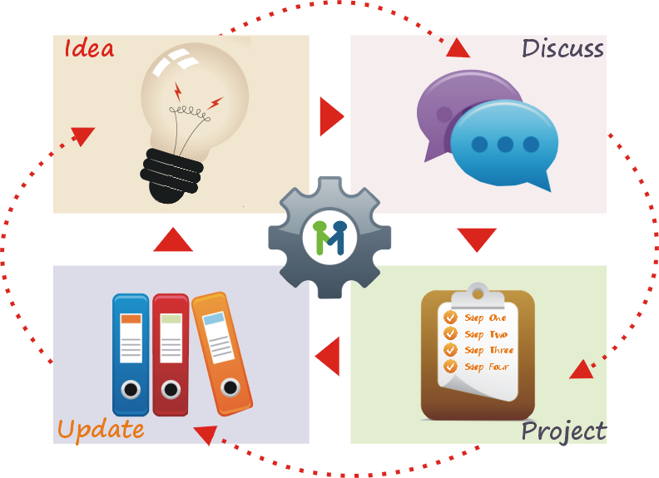
Improvements
A more complex and optimized Web-Crawler if time permitted. However, due to time constraint and lack of exposure, setback were encountered.
Image Retrieved from: <https://www.managehubaccelerator.com/wp-content/uploads/2013/01/managehub-continuous-improvement-cycle.png>
Notes:
Mauricio

Slide 13
Demo
Notes:
Anahit

Slide 14
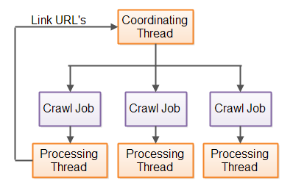
Conclusion
Crawlers can be versatile and can also be used for e-commerce, cyber security, and search engines.
Now, web crawlers are flexible, as they adjust to the user’s needs and the importance/relevance of the information.
Source: jenkov.com
Notes:
Mauricio

Slide 15
Reference
Castillo, Carlos, Mauricio Marin, Andrea Rodriguez, and Ricardo Baeza-Yates. "Focused Web Crawling." SpringerReference (n.d.): n. pag. Scheduling Algorithms for Web Crawling. Web. 24 Apr. 2016.
"Crawling & Indexing – Inside Search – Google." Crawling & Indexing– Inside Search – Google. N.p.,n.d. Web. 26 Apr. 2016.
Frankin, Curt. "How Internet Search Engines Work." HowStuffWorks. InfoSpace LLC, 27 Jan. 2000. Web. 27 Apr. 2016.
"How Google Works - Google Guide." How Google Works - Google Guide. N.p., n.d. Web. 27 Apr. 2016.
"Implementing an Effective Web Crawler." Implementing an Effective Web Crawler. N.p., n.d. Web. 27 Apr. 2016.
Janbandhun, Rashmi, Prashant Dahiwale, Issn:, and 488. "Analysis of Web Crawling Algorithms." International Journal on Recent and
Innovation Trends in Computing and Communication 2.3 (2014): 488-92. Web. 26 Apr. 2016.
Kumar, Rahul, Anurag Jain, and Chetan Agrawal. "SURVEY OF WEB CRAWLING ALGORITHMS." SURVEY OF WEB CRAWLING ALGORITHMS (n.d.): n. pag. Web. 24 Apr. 2016.
Menczer, Filippo, Gautam Pant, and Padmini Srinivasan. Topical Web Crawlers: Evaluating Adaptive Algorithms V (2004): 1-38. Web. 26 Apr. 2016.
Shah, Shalin. "Implementing an Effective Web Crawler." Implementing an Effective Web Crawler. N.p., n.d. Web. 22 Apr. 2016.

Slide 16
Q & A

